Slide 1
Solving the Preschool Conundrum – A Data-Driven Approach for ECDA
Guo Tiantian

Slide 2
Executive Summary
Issue: Persistent mismatch between childcare demand and preschool supply across subzones.
Solution: 5-year subzone-level forecast using population and preschool data.
Outcome: Identifies critical gaps, supports location planning.
Tool: Modular dashboard prototype to support real-time decision-making.

Slide 3
Objective
Forecast demand for childcare (18 months–6 years) at the subzone level.
01
Determine how many and where preschools are needed.
02
Provide ECDA a flexible tool for continuous updates.
03

Slide 4
Scope & Assumptions
Age group: 18 months to 6 years (≈ ages 2–6).
Capacity assumption: Each preschool can serve up to 100 children.
Forecast horizon: 5 years (2025–2029).
Data granularity: 412 subzones, aligned with HDB planning units.

Slide 5
Data Sources
Source | Dataset | Use
SingStat | Age-by-subzone population (2010–2020) | Historical trends
Data.gov.sg | Preschool locations | Supply estimation
GitHub | BTO mapping to subzones | Future demand driver
Internal | ECDA assumptions | Planning thresholds

Slide 6
Forecasting Methodology
Two-tier approach:
Fast forecast: Linear regression for speed and interpretability.
Advanced model: LSTM neural networks for subzones with complex trends.
Scenario engine: 720 combinations across population, BTO, and closure scenarios.

Slide 7
Key Results
Projected shortfall in 68 subzones by 2029.
Top 10 critical subzones by projected child–capacity gap.
Example: Sengkang West needs +4 centres by 2029.

Slide 8
Regional Insights
North-East: highest concentration of emerging demand.
Mature estates: flat or declining demand, with some over-supply.
Visual heatmap: Gap by subzone.

Slide 9
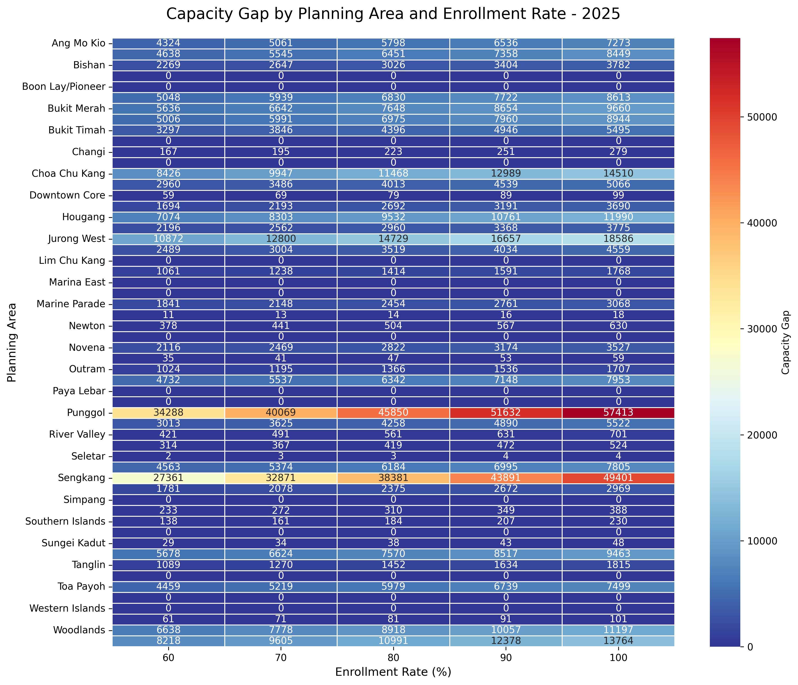
Enrollment Impact Heatmap

Slide 10
Dashboard Demo Highlights
Interactive map with demand/supply overlays.
Real-time scenario switching (720 combinations).
Toggle between forecasting models.
Exportable reports for planning use.

Slide 11
Benefits & ROI
Higher childcare accessibility = better work-family balance.
Data-driven site planning = smarter investments.
Scenario planning = lower long-term risk of over-/under-building.

Slide 12
Roadmap & Deployment
Phase | Timeline | Deliverable
1 | Done | Forecasting model + dashboard prototype
2 | Q3 | Beta dashboard + user training
3 | Q4–2025 | Fully integrated with ECDA internal systems

Slide 13
Limitations & Mitigations
No forward-looking birth rates or migration trends yet.
Childcare operator constraints not yet modeled.
Future work: add infant care and after-school segments.

Slide 14
Questions for Management
Should infant care (0–18 months) be forecasted too?
What policy thresholds define “critical shortage”?
Should private preschools be included in planning assumptions?

Slide 15
Summary – Why This Matters
Strategic, scalable, and evidence-based planning tool.
Delivers real-time insight for national early childhood infrastructure.
Ensures that no family is left behind due to childcare inaccessibility.

Slide 16
The End

